Slide 1
Supervised Learning
陈荣聪,林俊潼
2016.10.24

Slide 2
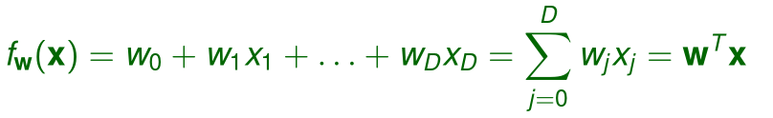
Linear regression
Linear regression

Slide 3
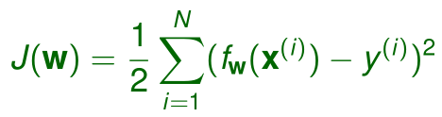
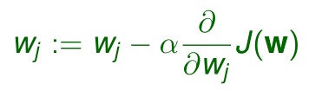

Least Mean Square Algorithm
Cost function:
Gradient descent:

Slide 4



Batch gradient descent:
Stochastic gradient descent:
Mini-batch based stochastic gradient descent:
batch:n

Slide 5

Probabilistic Assumptions
Relate the input and target via:
with IID Gaussian distributed:
or

Slide 6


Thus
Because:
Likelihood function：

Slide 7
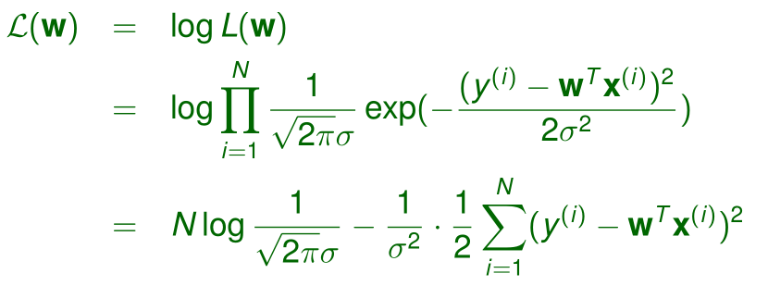

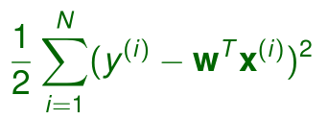
Log likelihood：
Maximizing gives the same answer as minimizing

Slide 8


Locally Weighted Linear Regression (LWR)
The LWR algorithm:
Fit w to minimize
Output
A standard choice for the weights is:
More general form is possible
The weights depend on the particular point x at which we are trying to
evaluate.
LWR is an example of non-parametric algorithm.

Slide 9
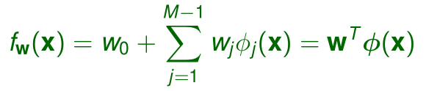

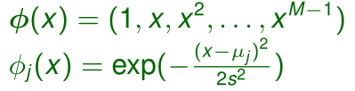

Linear Regression with Nonlinear Basis
Consider linear combinations of nonlinear basis functions of the input
variables:
Examples of basis functions:
Can still use least squares method to estimate(replace x with )
Linear method can model nonlinear functions through using nonlinear
basis functions.

Slide 10
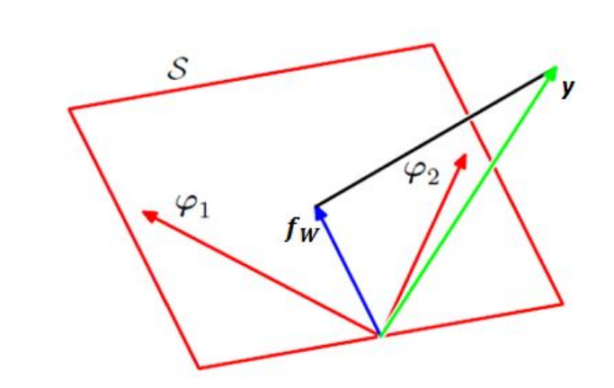


Geometry of Least Squares
If M < N, vectors span a linear subspace S of dimensionality M
is linear combination of vectors

Slide 11

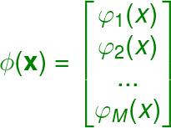


The least-squares regression function is the orthogonal projection of the target vector y onto the subspace S
，

Slide 12
Discriminative Classification

Slide 13
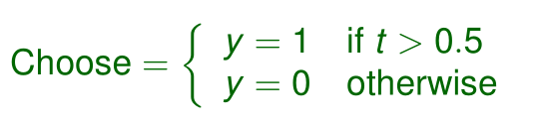
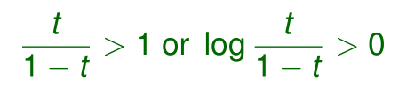
Two-Class Example
Let
Classification rule:
Equivalent test for classification rule: choose y = 1 if

Slide 14
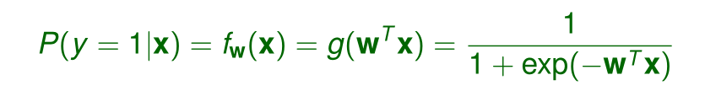

Logistic Regression
The posterior probability (or the hypothesis) is written as:
where g(·) is called logistic or sigmoid function.
The derivative of the sigmoid function:
Note that this is a model for classification rather than regression.

Slide 15
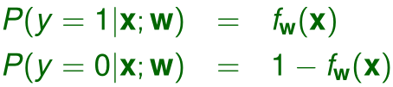

Since
thus
The likelihood of the parameters (given N training examples):

Slide 16
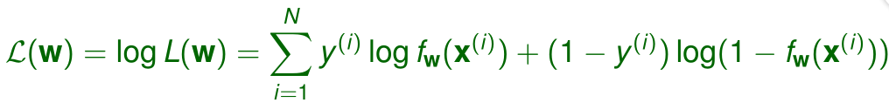





The log likelihood function:
As for one training example (x,y), maximizing the log likelihood gives:
Use the fact that
and

Slide 17

This therefore gives the stochastic gradient ascent rule:
The solution is identical to least mean squares update rule for linear
regression!

Slide 18





Discriminative vs. Generative classification
Discriminative classification: model the posterior probabilities or learn
discriminant function directly.
Compute : such as logistic regression.
Compute discriminant function: such as perceptron, SVM.
Makes an assumption on the form of the discriminants, but not the
densities.
Generative classification: explicitly or implicitly model the distribution
of inputs as well as outputs.
Assume a model for the class-conditional probability densities .
Estimate and from data, and apply Bayes’ rule to compute
the posterior probabilities :
= /
Perform optimal classification based on .

Slide 19




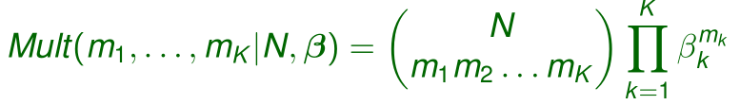
Bernoulli and Multinomial
Bernoulli: the distribution for a single binary variable ,governed by a single continuous parameter which represents the probability of x = 1
Binomial: gives the probability of observing m occurrences of x = 1 in
a set of N samples from a Bernoulli distribution.
Multinomial

Slide 20
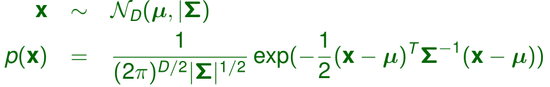
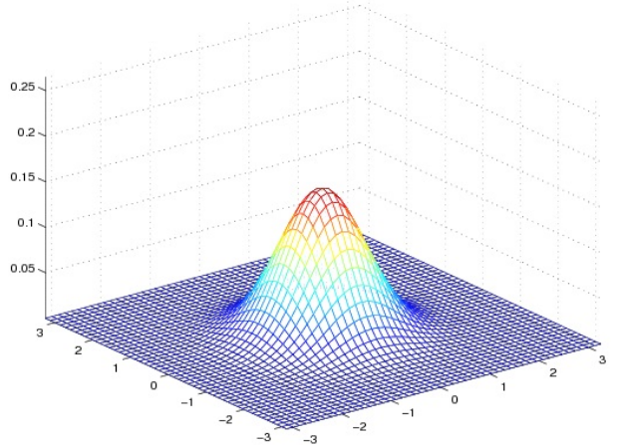

Multivariate Normal Distribution

Slide 21



Mahalanobis distance measures the distance from x to µ in terms of
:
is the D-dimensional hyperellipsoid centered
at µ. Its shape and orientation are defined by .
Euclidean distance is a special case of Mahalanobis distance when
; the hyperellipsoid degenerates into a hypersphere.

Slide 22
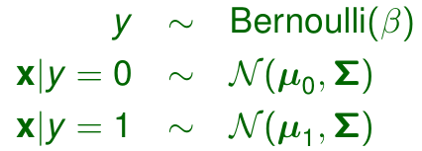
Gaussian Discriminant Analysis (GDA)
GDA models p(x|y) using a multivariate normal distribution:
The parameters of the model are {β,µ 0 ,µ 1 ,Σ}. Note that common
covariance matrix is usually used.

Slide 23
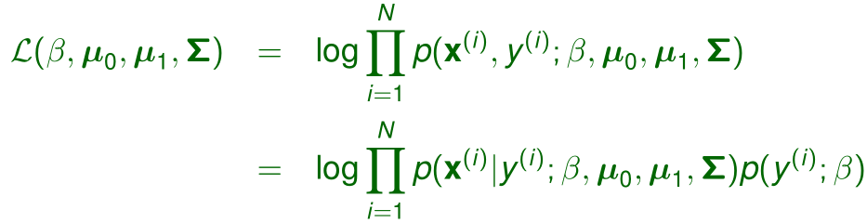


The log likelihood of the data is:

Slide 24
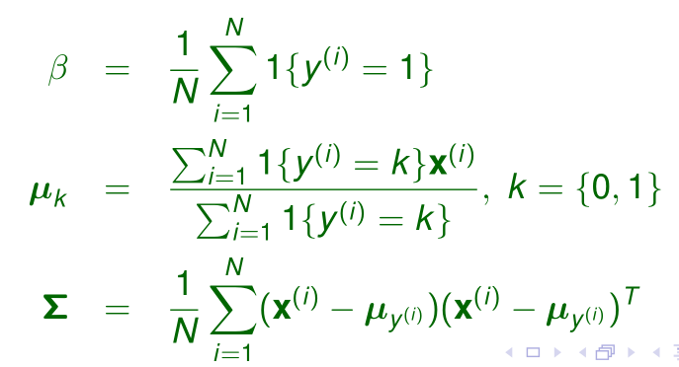
The maximum likelihood estimates are:

Slide 25

GDA and Logistic Regression
If we view P(y = 1|x;β,µ 0 ,µ 1 ,Σ) as a function of x, it can be expressed in the form:
where w is some appropriate function of β,µ 0 ,µ 1 ,Σ. This is exactly the form that
logistic regression (a discriminative algorithm) used to model P(y = 1|x).
GDA makes stronger modeling assumptions (i.e., p(x|y) is multivariate Gaussian) about
the data, and is more data efficient.
Logistic regression makes weaker assumptions, and is more robust to deviations from modeling assumptions.

Slide 26
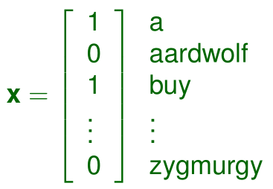




Email Spam Filter
Classifying emails to spam (y = 1) or non-spam (y = 0)
One example of broader set of problems called text classification
Feature vector:
,D is the size of the set of words (vocabulary).
Word selection: include words that appear in the emails but not in a dictionary; exclude very high frequency words; etc.
can take more general values in , then the model
is multinomial rather than binormial.

Slide 27

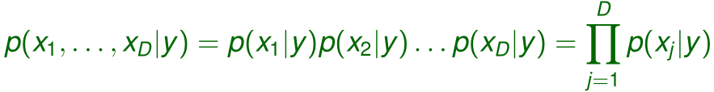

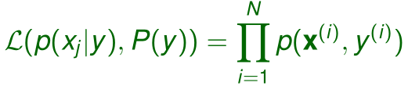
To model , we assume that are conditionally independent
given y. This is Naive Bayes assumption.
In Naive Bayes classifier:
Given a training set , the joint log likelihood of the data:

Slide 28

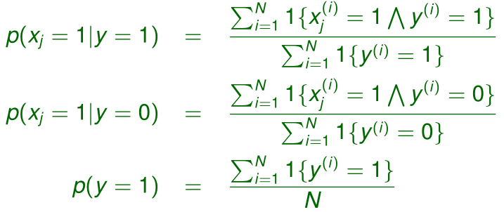
Maximizing w.r.t. gives the following estimates:

Slide 29
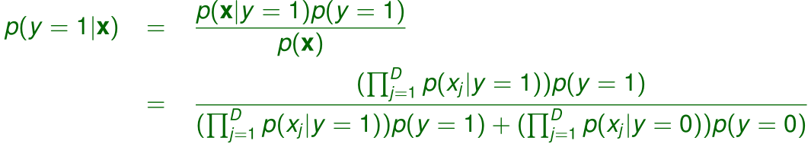
To make a prediction on a new example x, we simply calculate:
When the original, continuous-valued attributes are not well-modeled
by a multivariate normal distribution, discretizing the features and using
Naive Bayes (instead of GDA) will often result in a better classifier.

Slide 30


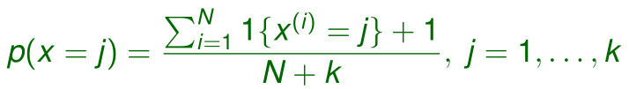


Laplace Smoothing
If you haven’t seen some word before in your finite training set, the
Naive Bayes classifier does not know how to make a decision.
To estimate the mean of multinomial random variable x taking values
{1,...,k}, given N observations , the maximum likelihood
estimates are:
Laplace smoothing:
still holds
for all j

Slide 31
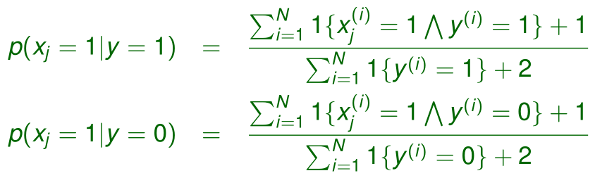
Returning to Naive Bayes classifier, with Laplace smoothing we obtain
the following estimates:
In practice, it usually doesn’t matter whether we apply Laplace smoothing to p(y = 1) or not, since we typically have a fair fraction between spam and non-spam emails.

Slide 32






Event Models for Text Classification
Naive Bayes uses multivariate Bernoulli event model: the probability
of an email was given by
A different way to represent emails: denotes the
word in the email, taking values in is the vocabulary; M
is the length of the email.
Multinomial event model: is now multinomial. The overall
probability of an email is

Slide 33




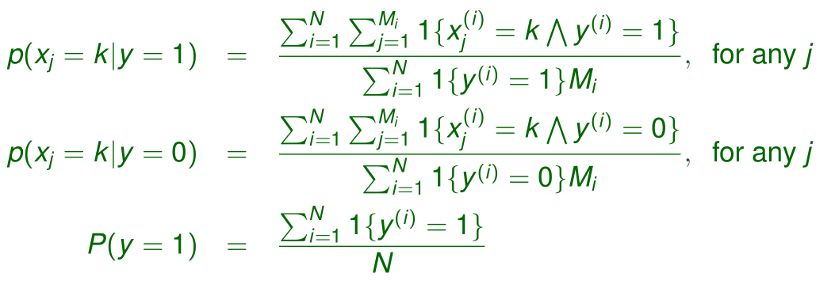
Given a training set , where
( is the number of words in training example),
the maximum likelihood estimates of the model are:

Slide 34
Naive Bayes vs. Logistic Regression
Asymptotic comparison (#training examples → infinite)
When model assumption is correct:
Naive Bayes (NB), Logistic regression (LR) produce identical classifier
When model assumption is incorrect:
LR is less biased - does not assume conditional, independence
therefore expected to outperform NB.

Slide 35
Non-asymptotic comparison
Convergence rate of parameter estimation - how many training examples needed to assume good estimates?
NB order logD (where D = # of attributes in X)
LR order D
NB converges more quickly to its asymptotic estimates.

Slide 36
Performance Evaluation and Comparison

Slide 37
Introduction
Two problems:
Performance evaluation: assessing the expected error rate of a
classification algorithm on a problem.
Performance comparison: comparing the expected error rates of two or
more classification algorithms to conclude which one is better.
Any conclusion drawn is conditioned on the given data set only. No
algorithm is the best for all possible datasets.
Training data alone is not sufficient for performance evaluation and
comparison.
A validation set is needed, typically requiring multiple runs to average
over different sources of randomness.
Performance evaluation and comparison is done based on the
distribution of the validation set errors.

Slide 38
We use error rate as the performance criterion here for performance
evaluation and comparison, but there exist some other performance
criteria depending on the application.
Examples of other criteria:
Risks based on more general loss functions than 0-1 loss
Training time and space complexity
Testing time and space complexity
Interpretability
Easy programmability

Slide 39
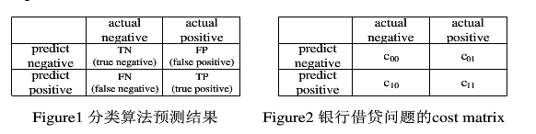

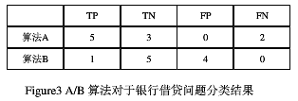
Cost-sensitive learning
Example
一般来说，算法的分类结果应该是将错误率降到最低(a),但在某些应用中，例如银行借贷问题，算法的分类结果是将银行的损失最少(b)。在所有错误的造成的损失都相等的情况下，(b)和(a)是等价的，但在银行借贷这个问题中，FN（贷款給不符合条件的申请人）的代价远大于FP（没有将贷款贷给符合条件的人）。则分类算法分类错误造成的损失为

Slide 40


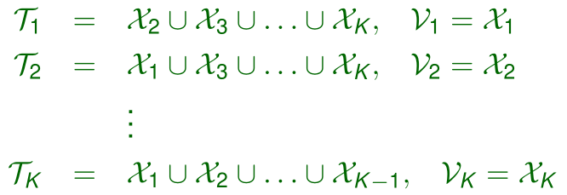
K-fold Cross Validation
The dataset is randomly partitioned into K equal-sized subsets
, called folds.
Stratification: the class distributions in different subsets are kept
roughly the same (stratified cross validation).
K training/validation set pairs :

Slide 41
Leave-One-Out
If N is small, K should be large to allow large enough training sets.
One extreme case of K-fold cross validation is leave-one-out where
only one instance is left out as the validation set and the remaining
N − 1 for training, giving N separate training/validation set pairs.

Slide 42

Bootstrapping
When the sample size N is very small, a better alternative to cross
validation is bootstrapping.
Bootstrapping generates new samples, each of size N, by drawing
instances randomly from the original sample with replacement.
The bootstrap samples usually overlap more than the cross validation
samples and hence their estimates are more dependent.
Probability that an instance is not chosen after N random draws:
So each bootstrap sample contains only approximately 63.2% of the
instances.
Multiple bootstrap samples are used to maximize the chance that the
system is trained on all the instances.

Slide 43
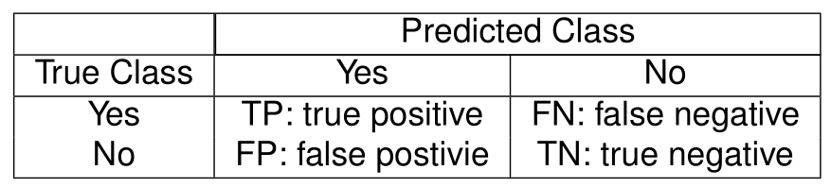
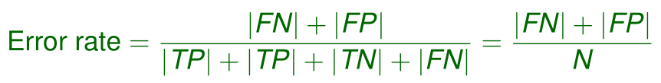


Error Measure
If 0 − 1 loss is used, error calculations will be based on the confusion
matrix:
Error rate:
where N is the total number of instances in the validation set.
For more general loss functions, the risks should be measured
instead.
For K > 2 classes, the class confusion matrix is a K × K matrix such
that its (i,j)-th entry contains the number of instances that belong to
but are assigned to .

Slide 44
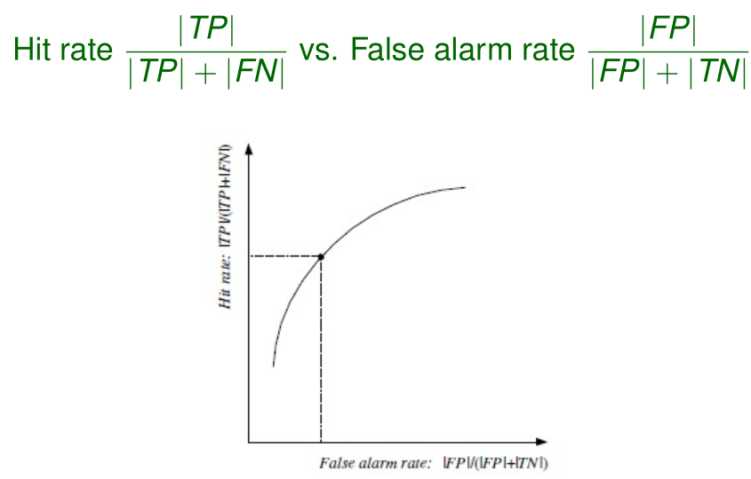
ROC Curve
Receiver operating characteristics (ROC) curve:
The curve is obtained by varying a certain parameter (e.g., threshold
for making decision) of the classification algorithm.
The area under curve (AUC) is often used as a performance measure.

Slide 45
Point Estimation vs. Interval Estimation
A point estimator (e.g., MLE) specifies a value for a parameter θ.
An interval estimator specifies an interval within which θ lies with a
certain degree of confidence.
The probability distribution of the point estimator is used to obtain an
interval estimator.

Slide 46






Example: Estimation of Mean of Normal Distributio
Given an i.i.d. sample , where
Point estimation of the mean µ:
since are i.i.d.
Define a statistic with a unit normal distribution:

Slide 47



Two-Sided Confidence Interval
For a unit normal distribution, about 95% of lies in (−1.96,1.96):
or
meaning that with 95% confidence, µ lies within units of the
sample mean m.

Slide 48

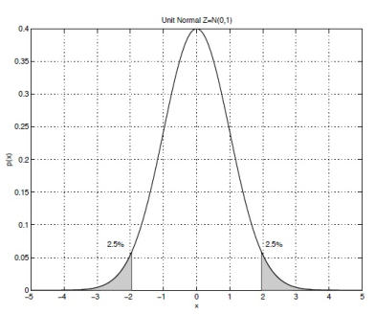




Let us denote such that
Because is symmetric around the mean, we have
Hence, for any specified level of confidence 1 − α,
we have
or

Slide 49
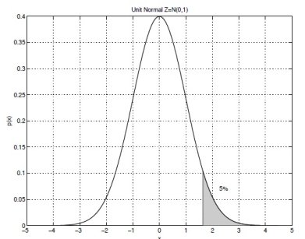


One-Sided Upper Confidence Interval
P( < 1.64) = 0.95
95% one-sided upper confidence interval for µ:
or

Slide 50

The one-sided upper confidence interval defines a lower bound for µ.
In general, a 100(1 − α) percent one-sided upper confidence interval
for µ can be computed from
The one-sided lower confidence interval that defines an upper bound
can be calculated similarly.

Slide 51






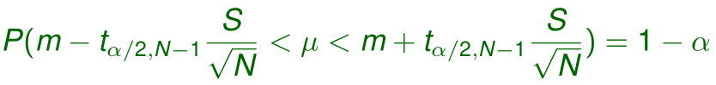
t Distribution
When the variance is not known ,let
The statistic follows a t distribution with N − 1 degrees
of freedom:
For any
or

Slide 52
One-sided confidence intervals can also be defined.
The t distribution has larger spread (longer tails) than the unit normal
distribution, and generally the interval given by the t distribution is
larger due to additional uncertainty about the unknown variance.
As N increases, the t distribution will get closer to the normal
distribution.( )

Slide 53
Hypothesis Testing
Instead of explicitly estimating some parameters, hypothesis testing
uses the sample to test some hypothesis concerning the parameters,
e.g., whether the mean is < 0.02.
Hypothesis testing:
We define a statistic that obeys a certain distribution if the hypothesis is
correct.
If the random sample is consistent with the hypothesis under consideration
(i.e., if the statistic calculated from the sample has a hige enough probability
of being drawn from the probability), the hypothesis is accepted.
Otherwise the hypothesis is rejected.
There are parametric and nonparametric tests. Only parametric tests
are considered here.

Slide 54




Null Hypothesis
Given a sample from a normal distribution where σ is known
but µ is unknown.
We want to test a specific hypothesis about µ, called the null
hypothesis, e.g.,
against the alternative hypothesis
for some specified constant

Slide 55



Two-Sided Test
We accept if the sample mean m, a point estimate of µ, is not too
far from .
We accept with level of significance α if lies in the 100(1 − α)
percent confidence interval, i.e.,

Slide 56


One-Sided Test
Null and alternative hypotheses:
We accept with level of significance α if

Slide 57





t Tests
If the variance is not known, the sample variance will be used
instead and so
Two-sided t test:
We accept at significance level α if
One-side t test can be defined similarly.

Slide 58




Binomial Test
Single training/validation set pair: a classifier is trained on a training
set and tested on a validation set .
Let p be the (unknown) probability that the classifier makes a
misclassification error.
For the ith instance in , we define as a Bernoulli variable to
denote the correctness of the classifier’s decision:
Point estimate of p:

Slide 59





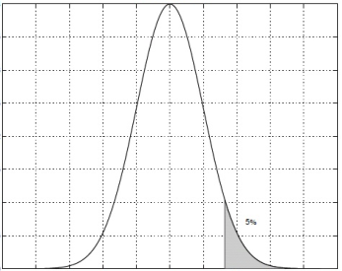

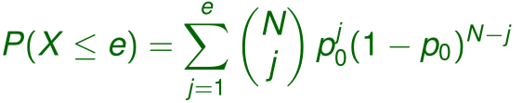
Hypothesis test:
Given that the classifier makes e errors on with , can we say
that the classifier has error probability p 0 or less?
Let denote the number of errors on .
Because are independent Bernoulli variables, X is binomial:
Under the null hypothesis , so the probability that there are e
errors or less is
Binomial test: accept if P(X ≤ e) < 1 − α; reject otherwise.

Slide 60




Paired t Test
Multiple training/validation set pairs: if we run the algorithm K times
on K training/validation set pairs, we get K error probabilities,
, k = 1,...,K, on the K validation sets.
We can use the paired t test to determine whether to accept the null
hypothesis that the classifier has error probability or less at
significance level α.
Bernoulli variables:
Test statistic:
where

Slide 61








K-Fold Cross-Validated Paired t Test
Given two classification algorithms and a data set, we want to
compare and test whether the two algorithms construct classifiers that
have the same expected error rate on a new instance.
K-fold cross validation is used to obtain K training/validation set pairs,
For each training/validation set pair , the two classification
algorithms are trained on and tested on , with error probabilities
and
We define
The distribution of is used for hypothesis testing.
if and are both normally distributed, then should also be
normal (with mean µ).

Slide 62
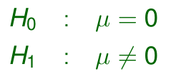



Null and alternative hypotheses:
Test statistic:
where
K-fold CV paired t test: accept at significance level α if
; reject otherwise.

